Slide 1
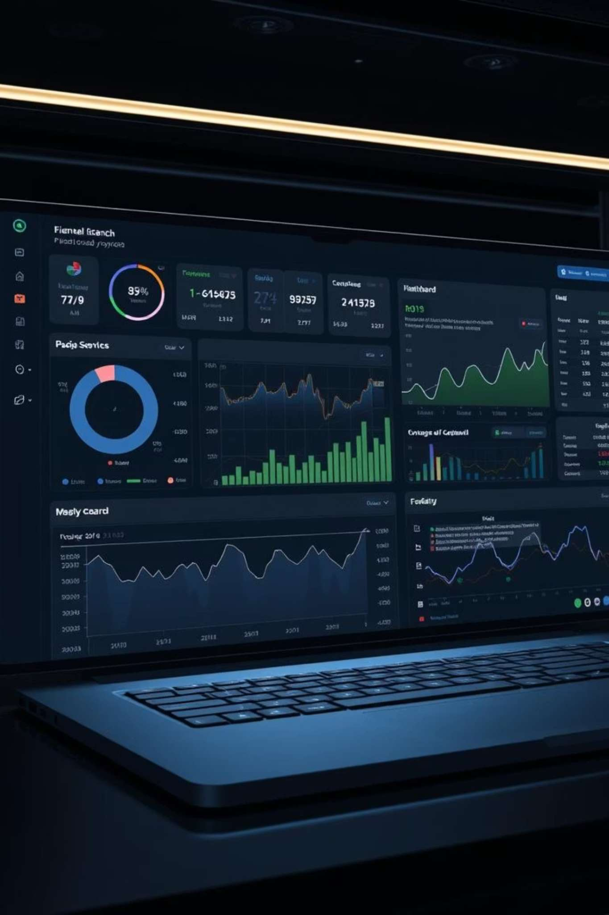
An Intelligent Personal Finance Tracking & Analysis System (Python)
Submitted By:
Fiza – Luqman (SP24-BCS-038)
Jaweria Nasir (SP24-BCS-157)
Arisha Inayat (SP24-BCS-159)

Slide 2
Introduction
Managing money is challenging without a clear understanding of income, expenses, and spending patterns. Finance tracker designed to help users:
Record transactions easily
Understand their spending behaviour
Receive predictions and insights
Improve financial health
It is a CLI (Command Line Interface) system — simple, fast, and powerful.

Slide 3
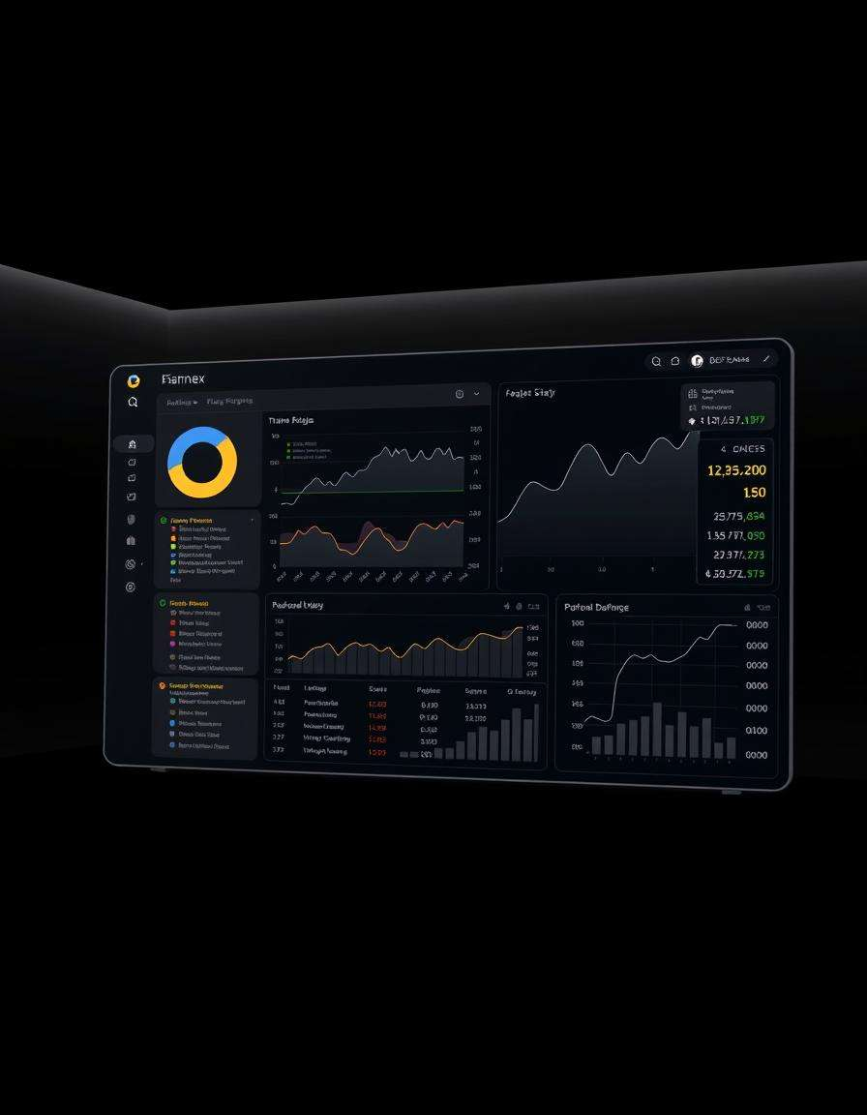
Project Aim
The aim of this project is to build a system that:
Keeps track of daily financial activities
Analyses user spending
Predicts future expenses
Detects patterns & unusual behaviour
Helps users make better financial decisions
This system works like a personal finance assistant.

Slide 4
Scope of the System
The system supports:
Income management
Expense management
Monthly & weekly tracking
Predictions and analytics
Budget planning
Smart detection features such as subscriptions and bills
It is suitable for students, individuals, freelancers, and households.

Slide 5
Unique Features
🌟 What Makes this project Unique?
1
2
3
AI-Based Budget Planner (A Algorithm)*
Expense Prediction System
Spike Detection
Predicts next 7 days’ expenses using trend analysis and average models.
Finds sudden unusual increases in specific categories.
Creates a customized savings plan by calculating category-wise reductions.
4
5
6
Smart Bill & Subscription Detection
Spending Streak Tracker
Financial Health Score (0–100)
Automatically identifies repeating bills and monthly subscriptions.
Counts how many days the user stayed under a daily budget.
Rates the user's overall financial stability.
7
Pareto 80/20 Insight
Shows top spending categories contributing to 80% of expenses.
These features make the project highly advanced compared to typical student finance trackers.

Slide 6

Financial Health Score
A powerful summary feature that calculates:
Savings rate
Spending stability
Category distribution
Overall financial behaviour
Score Range: 0–100 Higher score = better financial control.

Slide 7
System Features (Detailed)
✔ Transaction Management
✔ Summaries
✔ Analytics
Monthly summary
Category-wise breakdown
Add, edit, delete income/expense
Weekly breakdown
Expense distribution
Auto-category suggestion
Net balance calculation
High-spending categories
Organized records with ID, date, amount, description

Slide 8

AI-Based Expense Prediction
The system predicts upcoming expenses for specific categories:
Uses linear regression trend for accuracy
Switches to monthly average estimation if data is limited
Helps users prepare for future spending
Prevents unexpected financial stress
This makes the system data-driven and smart.

Slide 9

Expense Spike Detection
This feature compares spending between the current and previous month.
Detects:
Sudden rise in expenses
Overspending habits
New categories where money is spent
It helps users immediately notice harmful financial patterns.
Spending Streak Tracker
Tracks how many days the user stays under a calculated daily budget.
Encourages disciplined spending
Motivates users to save
Builds healthy financial habits
This is not found in common finance apps or student projects.

Slide 10
A Based Budget Planner*
★ This is the most advanced feature of the project.
How it works:
User gives a savings target (amount or percentage)
Algorithm finds the best combination of category reductions
Considers priority categories
Allows protecting necessary categories
Generates a clear reduction plan
This adds AI thinking into your finance system.
Smart Automation Features
✔ Bill Detection
✔ Subscription Detection
✔ Pareto 80/20 Insight
Detects electricity, rent, internet bill patterns
Finds recurring monthly expenses
Shows top categories responsible for 80% of spending
Predicts next due date
Helps users reduce unnecessary subscriptions
Helps avoid late payments
Enables smarter budgeting

Slide 11
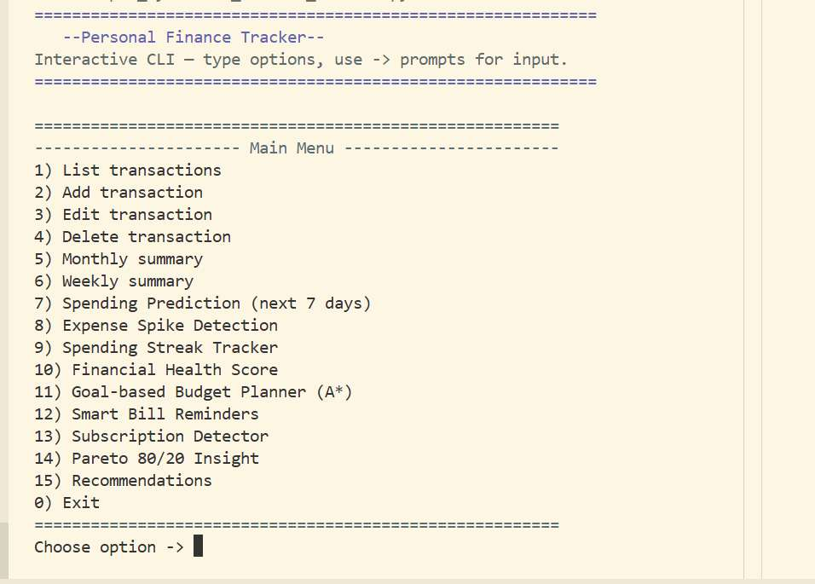
CODE OUTPUT

Slide 12
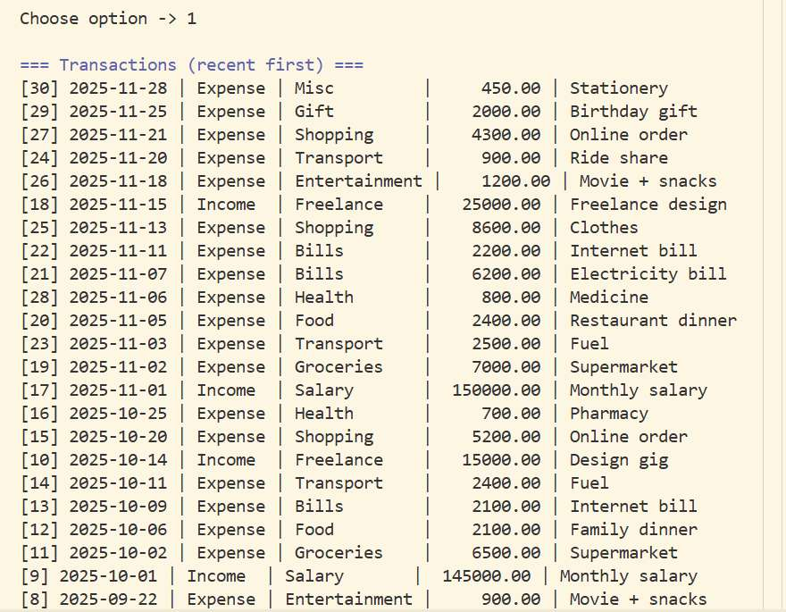

Slide 13
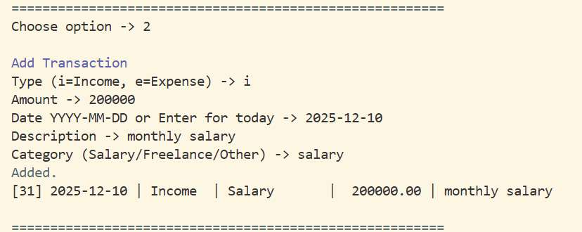
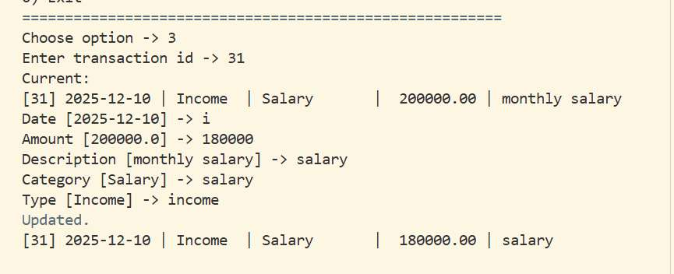
ADD TRANSACTION
EDIT TRANSACTION

Slide 14
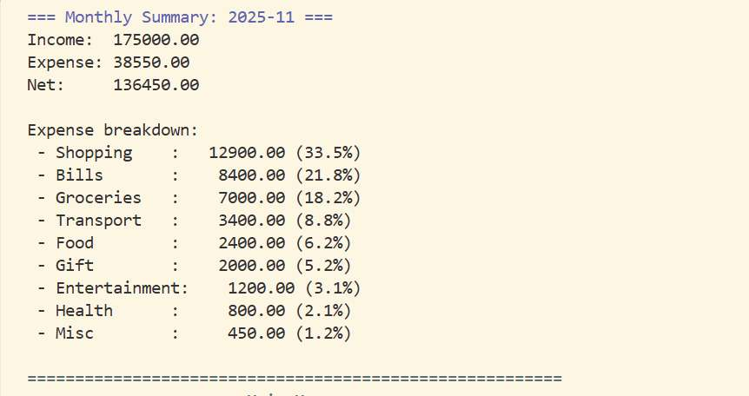

Slide 15
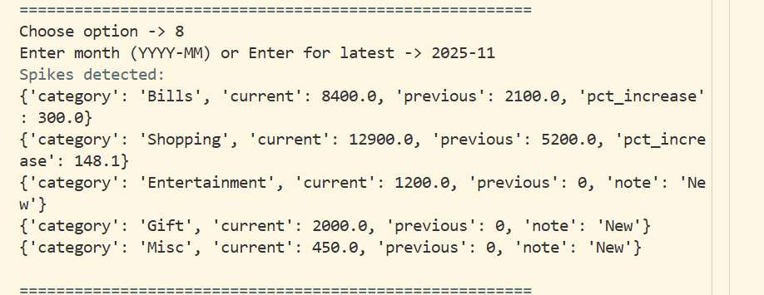
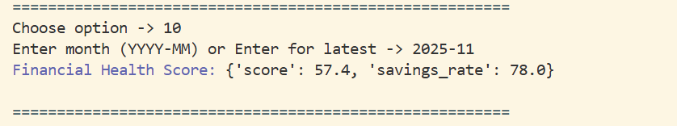
SPIKE DETECTION
FINANCIAL HEALTH SCORE

Slide 16
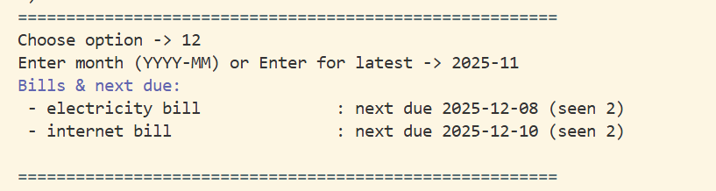
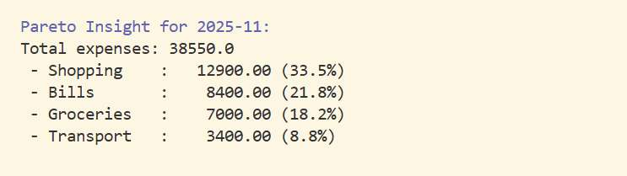
SMART BILL REMINDER
PARETO INSIGHT

Slide 17


